Slide 1
Power BI Introduction
By Angad singh

Slide 2
Table of Contents
Introduction about Power BI
Power BI Desktop
Report view
Data view
Relationships view
Power BI Service
Datasets
Reports
Dashboards
Workbooks
Workspace
Power BI Mobile Apps
Power BI Data connectors
Introduction about visuals

Slide 3


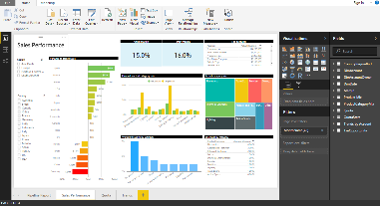
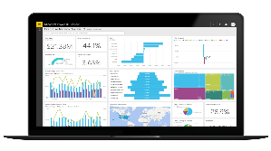
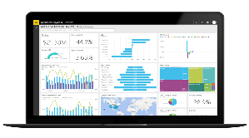
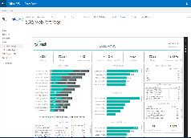
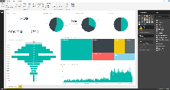
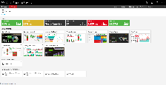
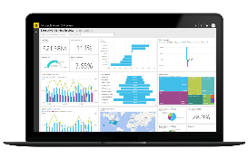

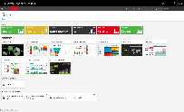
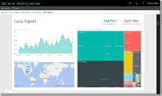

An overview of Power BI
Power Bi is a visualization tool provided by microsoft. It aims to provide interactive visualizations and business intelligence capabilities with an interface simple enough for end users to create their own reports and dashboards.
It is having three major parts -
Create
Publish
Consume
Create interactive reports in Power BI Desktop
Publish to Power BI Services
View and interact in Power BI Mobile or web browser

Slide 4
What is Power BI Desktop?
Power BI Desktop is a free application you can install on your local computer that lets you connect to, transform, and visualize your data.
Power BI Desktop can be divided into three categories or views, for how you can interact with data and create reports:-
Report view: A canvas for building and viewing reports based on the datasets defined in Data view.
Data view: Data View helps you inspect, explore, and understand data in your Power BI Desktop model.
Relationships view: Identified relationships between the datasets defined in Data view. When possible, Power BI Desktop identifies the relationships automatically, but you can also define them manually.
Install Power Bi desktop ---> Download free
Signing up for Power BI Service

Slide 5
Power BI service
Power BI service is a cloud-based business analytics service that enables anyone to visualize and analyze data with greater speed, efficiency, and understanding.
These four items represent the primary components of Power Bi service:-
Dataset: Collection of related data that you import or connect to. A dataset is similar to a database table.
Report: One or more pages of visualizations based on a single dataset. A report can be associated with only one workspace, but it can be associated with multiple dashboards within that workspace.
Dashboard: A presentation canvas that contains zero or more tiles or widgets. A dashboard can be associated with only one workspace, but it can display visualizations from multiple datasets or reports.
Workspace: A container for datasets, reports, and dashboards. The Power BI service supports two types of workspaces: My Workspace and app workspaces, which you access through the Workspaces section in the left navigation pane. My Workspace is a personal work area provided automatically when you log into the service. Only you can access this space. An app workspace is used to share and collaborate on content.

Slide 6
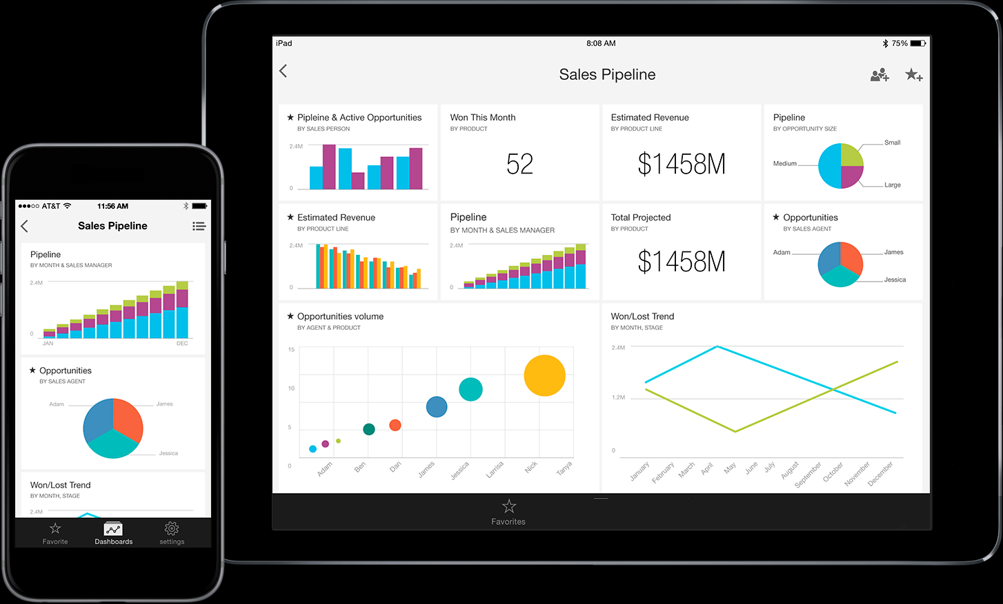
Power BI Mobile Apps
Microsoft offers Power BI mobile apps for iOS, Android, and Windows mobile devices. The apps make it possible to provide specific users with access the Power BI dashboards, reports, and apps, while taking into account the form factor of the smaller devices.

Slide 7
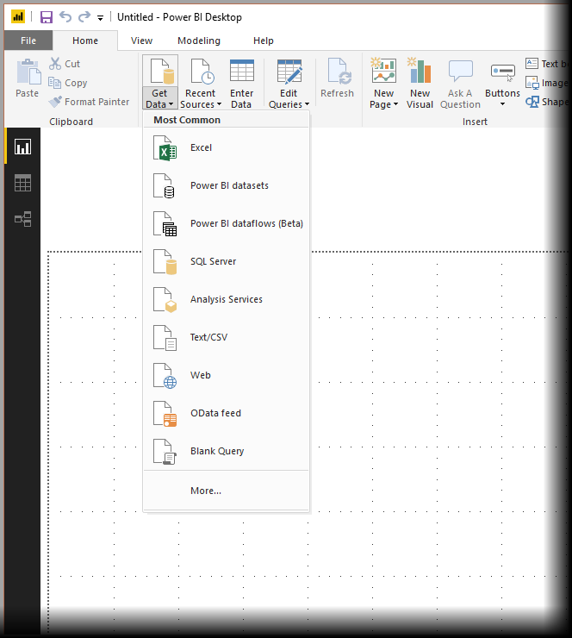
Power BI Data connectors
With Power BI Desktop, you can connect to data from many different sources.
To connect to data, select Get Data from the Home ribbon. Selecting the down arrow, or the Get Data text on the button.
Data types are organized in the following categories:
All
File
Database
Power BI
Azure
Online Services
Other

Slide 8
Introduction about visuals
Visualization is the basic building blocks of any Business Intelligence tool.
Default visuals
Power BI contains various default data visualization components that include simple bar charts to pie charts to maps, and also complex models such as waterfalls, funnels, gauges, and many other components.
In Power BI, you can create visualization in two ways. First is by adding from the right side pane to Report Canvas. By default, it is the table/chart type visualization, which is selected by the Power BI. Another way is to drag the fields from right side bar to the axis and value axis under Visualization. You can add multiple fields to each axis as per the requirement.
Marketplace visuals
Members of the community, as well as Microsoft, have contributed their custom visuals to the benefit of the public and published them to AppSource marketplace. These visuals can be downloaded and added to Power BI reports. All of these custom visuals have been tested and approved by Microsoft for functionality and quality.

Slide 9
Questions?

